Slide 1

DATABASE MANAGEMENT SYSTEMS
Student Information Management System (SIMS)

Slide 2

Purpose of the Project:
The main objective of the project is to create a comprehensive Student Record Keeping System that manages student's information about their own and other students, their academic performance, but in a way that keeps their fees and related data confidential so that other students cannot look into their private.
To enable student records to be easily retrieved and updated by admin.
Facilitate tracking of students' academic progress, course details, grades, and fee payment status.

Slide 3
UML and Relational Diagramming:
UML Diagram:
Class Diagram: represents classes such as Administrator, Student, Course, Grades, Fee and Scholarship with their relationships.
Use Case Diagram: It shows the interactions between users and the system, it was made by the admin to perform actions such as adding students, updating grades and viewing fee details.

Slide 4
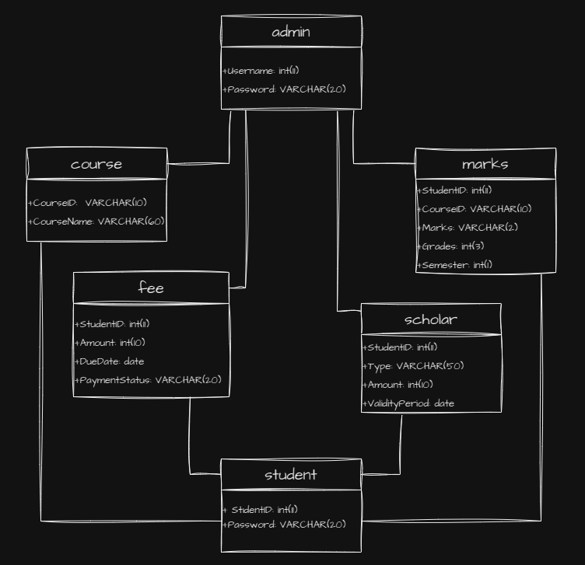

Slide 5
Relational Schema:
Student Table (StudentID, Password)
Course Table (CourseID, CourseName)
Marks Table (StudentID, CourseID, Marks, Grades, Semester)
Fee Table (StudentID, Amount, DueDate, PaymentStatus)
Scholarship Table (StudentID, Type, Amount, ValidityPeriod)

Slide 6
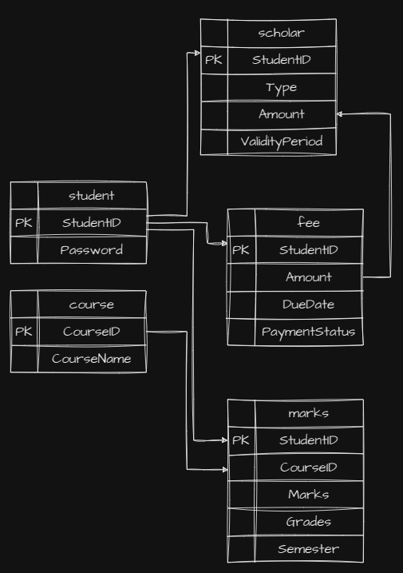

Slide 7
Programming Language and Justification:
I used a combination of PHP, HTML, CSS, and JavaScript for the front end, while I used the XAMPP stack (which includes Apache, MySQL, PHP, and Perl) for the back end and database.
I used HTML to create the structure of the web pages, define forms and configure content, CSS to add style, and JavaScript to enhance the user experience, including client-side interaction, form validation and updates via buttons.
For the database connection, I added SQL queries to connect with PHP, MySQL database (XAMPP) and to add, delete and update data.
In order to perform server-side validation, I performed server-side form validation with PHP to ensure data integrity and security so that it interacts with the database and is associated with the database.
In XAMPP, I used Apache and MySQL content.

Slide 8
Project Performance:
I performed regular testing and debugging to ensure the reliability, security and correctness of the system.
I ensured that the system worked seamlessly with the XAMPP environment by addressing compatibility issues that may arise during the development and deployment phases. I performed extensive testing to identify and resolve potential issues.

Slide 9
THANK YOU FOR LISTENING

